Slide 1
DATA MINING LECTURE 1
Introduction

Slide 2
What is data mining?
After years of data mining there is still no unique answer to this question.
A tentative definition:
Data mining is the use of efficient techniques for the analysis of very large collections of data and the extraction of useful and possibly unexpected patterns in data.

Slide 3
Why do we need data mining?
Really, really huge amounts of raw data!!
In the digital age, TB of data is generated by the second
Mobile devices, digital photographs, web documents.
Facebook updates, Tweets, Blogs, User-generated content
Transactions, sensor data, surveillance data
Queries, clicks, browsing
Cheap storage has made possible to maintain this data
Need to analyze the raw data to extract knowledge

Slide 4
Why do we need data mining?
“The data is the computer”
Large amounts of data can be more powerful than complex algorithms and models
Google has solved many Natural Language Processing problems, simply by looking at the data
Example: misspellings, synonyms
Data is power!
Today, the collected data is one of the biggest assets of an online company
Query logs of Google
The friendship and updates of Facebook
Tweets and follows of Twitter
Amazon transactions
We need a way to harness the collective intelligence

Slide 5
The data is also very complex
Multiple types of data: tables, time series, images, graphs, etc
Spatial and temporal aspects
Interconnected data of different types:
From the mobile phone we can collect, location of the user, friendship information, check-ins to venues, opinions through twitter, images though cameras, queries to search engines

Slide 6
Example: transaction data
Billions of real-life customers:
WALMART: 20M transactions per day
AT&T 300 M calls per day
Credit card companies: billions of transactions per day.
The point cards allow companies to collect information about specific users

Slide 7
Example: document data
Web as a document repository: estimated 50 billions of web pages
Wikipedia: 4 million articles (and counting)
Online news portals: steady stream of 100’s of new articles every day
Twitter: ~300 million tweets every day

Slide 8
Example: network data
Web: 50 billion pages linked via hyperlinks
Facebook: 500 million users
Twitter: 300 million users
Instant messenger: ~1billion users
Blogs: 250 million blogs worldwide, presidential candidates run blogs

Slide 9
Example: genomic sequences
http://www.1000genomes.org/page.php
Full sequence of 1000 individuals
3*10⁹ nucleotides per person → 3*10¹² nucleotides
Lots more data in fact: medical history of the persons, gene expression data

Slide 10
Example: environmental data
Climate data (just an example)
http://www.ncdc.gov/oa/climate/ghcn-monthly/index.php
“a database of temperature, precipitation and pressure records managed by the National Climatic Data Center, Arizona State University and the Carbon Dioxide Information Analysis Center”
“6000 temperature stations, 7500 precipitation stations, 2000 pressure stations”
Spatiotemporal data

Slide 11
Behavioral data
Mobile phones today record a large amount of information about the user behavior
GPS records position
Camera produces images
Communication via phone and SMS
Text via facebook updates
Association with entities via check-ins
Amazon collects all the items that you browsed, placed into your basket, read reviews about, purchased.
Google and Bing record all your browsing activity via toolbar plugins. They also record the queries you asked, the pages you saw and the clicks you did.
Data collected for millions of users on a daily basis

Slide 12
So, what is Data?
Attributes
Collection of data objects and their attributes
An attribute is a property or characteristic of an object
Examples: eye color of a person, temperature, etc.
Attribute is also known as variable, field, characteristic, or feature
A collection of attributes describe an object
Object is also known as record, point, case, sample, entity, or instance
Objects
Size: Number of objects
Dimensionality: Number of attributes
Sparsity: Number of populated
object-attribute pairs

Slide 13
Types of Attributes
There are different types of attributes
Categorical
Examples: eye color, zip codes, words, rankings (e.g, good, fair, bad), height in {tall, medium, short}
Nominal (no order or comparison) vs Ordinal (order but not comparable)
Numeric
Examples: dates, temperature, time, length, value, count.
Discrete (counts) vs Continuous (temperature)
Special case: Binary attributes (yes/no, exists/not exists)

Slide 14
Numeric Record Data
If data objects have the same fixed set of numeric attributes, then the data objects can be thought of as points in a multi-dimensional space, where each dimension represents a distinct attribute
Such data set can be represented by an n-by-d data matrix, where there are n rows, one for each object, and d columns, one for each attribute

Slide 15
Categorical Data
Data that consists of a collection of records, each of which consists of a fixed set of categorical attributes

Slide 16
Document Data
Each document becomes a `term' vector,
each term is a component (attribute) of the vector,
the value of each component is the number of times the corresponding term occurs in the document.
Bag-of-words representation – no ordering

Slide 17
Transaction Data
Each record (transaction) is a set of items.
A set of items can also be represented as a binary vector, where each attribute is an item.
A document can also be represented as a set of words (no counts)
Sparsity: average number of products bought by a customer

Slide 18
Ordered Data
Genomic sequence data
Data is a long ordered string

Slide 19
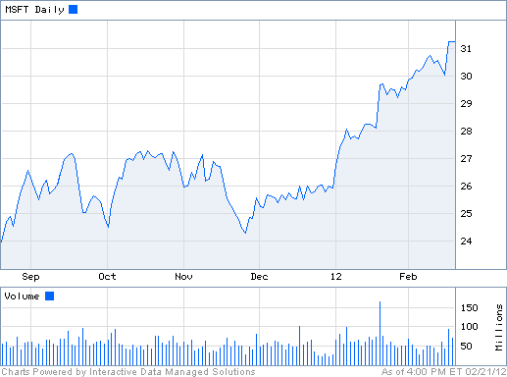
Ordered Data
Time series
Sequence of ordered (over “time”) numeric values.

Slide 20
Graph Data
Examples: Web graph and HTML Links

Slide 21
Types of data
Numeric data: Each object is a point in a multidimensional space
Categorical data: Each object is a vector of categorical values
Set data: Each object is a set of values (with or without counts)
Sets can also be represented as binary vectors, or vectors of counts
Ordered sequences: Each object is an ordered sequence of values.
Graph data

Slide 22
What can you do with the data?
Suppose that you are the owner of a supermarket and you have collected billions of market basket data. What information would you extract from it and how would you use it?
What if this was an online store?
Product placement
Catalog creation
Recommendations

Slide 23
What can you do with the data?
Suppose you are a search engine and you have a toolbar log consisting of
pages browsed,
queries,
pages clicked,
ads clicked
each with a user id and a timestamp. What information would you like to get our of the data?
Ad click prediction
Query reformulations

Slide 24
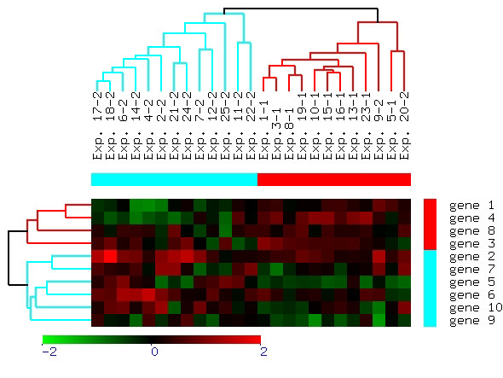
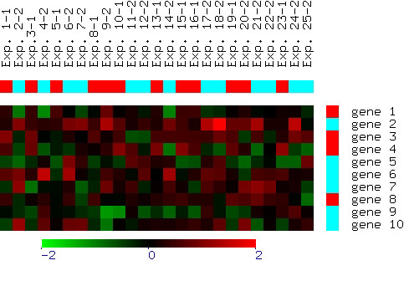
What can you do with the data?
Suppose you are biologist who has microarray expression data: thousands of genes, and their expression values over thousands of different settings (e.g. tissues). What information would you like to get out of your data?
Groups of genes and tissues

Slide 25
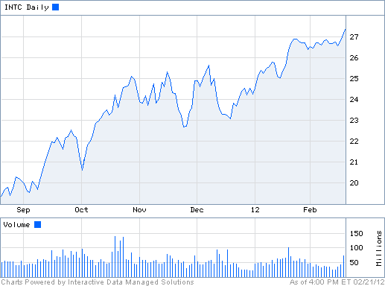
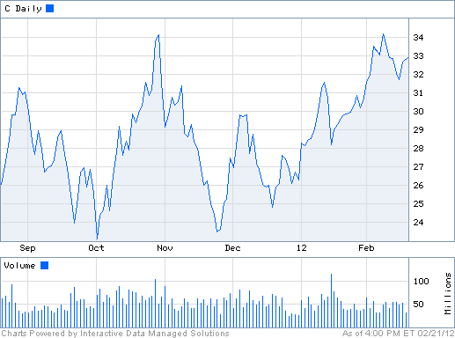
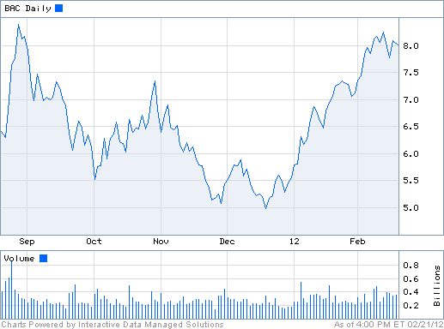
What can you do with the data?
Suppose you are a stock broker and you observe the fluctuations of multiple stocks over time. What information would you like to get our of your data?
Clustering of stocks
Correlation of stocks
Stock Value prediction

Slide 26
What can you do with the data?
You are the owner of a social network, and you have full access to the social graph, what kind of information do you want to get out of your graph?
Who is the most important node in the graph?
What is the shortest path between two nodes?
How many friends two nodes have in common?
How does information spread on the network?

Slide 27
Why data mining?
Commercial point of view
Data has become the key competitive advantage of companies
Examples: Facebook, Google, Amazon
Being able to extract useful information out of the data is key for exploiting them commercially.
Scientific point of view
Scientists are at an unprecedented position where they can collect TB of information
Examples: Sensor data, astronomy data, social network data, gene data
We need the tools to analyze such data to get a better understanding of the world and advance science
Scale (in data size and feature dimension)
Why not use traditional analytic methods?
Enormity of data, curse of dimensionality
The amount and the complexity of data does not allow for manual processing of the data. We need automated techniques.

Slide 28
What is Data Mining again?
“Data mining is the analysis of (often large) observational data sets to find unsuspected relationships and to summarize the data in novel ways that are both understandable and useful to the data analyst” (Hand, Mannila, Smyth)
“Data mining is the discovery of models for data” (Rajaraman, Ullman)
We can have the following types of models
Models that explain the data (e.g., a single function)
Models that predict the future data instances.
Models that summarize the data
Models the extract the most prominent features of the data.

Slide 29
What can we do with data mining?
Some examples:
Frequent itemsets and Association Rules extraction
Coverage
Clustering
Classification
Ranking
Exploratory analysis

Slide 30
Frequent Itemsets and Association Rules
Given a set of records each of which contain some number of items from a given collection;
Identify sets of items (itemsets) occurring frequently together
Produce dependency rules which will predict occurrence of an item based on occurrences of other items.
Itemsets Discovered:
{Milk,Coke}
{Diaper, Milk}
Rules Discovered:
{Milk} --> {Coke}
{Diaper, Milk} --> {Beer}
Tan, M. Steinbach and V. Kumar, Introduction to Data Mining

Slide 31
Frequent Itemsets: Applications
Text mining: finding associated phrases in text
There are lots of documents that contain the phrases “association rules”, “data mining” and “efficient algorithm”
Recommendations:
Users who buy this item often buy this item as well
Users who watched James Bond movies, also watched Jason Bourne movies.
Recommendations make use of item and user similarity

Slide 32
Association Rule Discovery: Application
Supermarket shelf management.
Goal: To identify items that are bought together by sufficiently many customers.
Approach: Process the point-of-sale data collected with barcode scanners to find dependencies among items.
A classic rule --
If a customer buys diaper and milk, then he is very likely to buy beer.
So, don’t be surprised if you find six-packs stacked next to diapers!
Tan, M. Steinbach and V. Kumar, Introduction to Data Mining

Slide 33
Clustering Definition
Given a set of data points, each having a set of attributes, and a similarity measure among them, find clusters such that
Data points in one cluster are more similar to one another.
Data points in separate clusters are less similar to one another.
Similarity Measures?
Euclidean Distance if attributes are continuous.
Other Problem-specific Measures.
Tan, M. Steinbach and V. Kumar, Introduction to Data Mining

Slide 34
Illustrating Clustering
Euclidean Distance Based Clustering in 3-D space.
Intracluster distances
are minimized
Intercluster distances
are maximized
Tan, M. Steinbach and V. Kumar, Introduction to Data Mining

Slide 35
Clustering: Application 1
Bioinformatics applications:
Goal: Group genes and tissues together such that genes are coexpressed on the same tissues

Slide 36
Clustering: Application 2
Document Clustering:
Goal: To find groups of documents that are similar to each other based on the important terms appearing in them.
Approach: To identify frequently occurring terms in each document. Form a similarity measure based on the frequencies of different terms. Use it to cluster.
Gain: Information Retrieval can utilize the clusters to relate a new document or search term to clustered documents.
Tan, M. Steinbach and V. Kumar, Introduction to Data Mining

Slide 37
Clustering of S&P 500 Stock Data
Observe Stock Movements every day.
Cluster stocks if they change similarly over time.
Tan, M. Steinbach and V. Kumar, Introduction to Data Mining

Slide 38
Coverage
Given a set of customers and items and the transaction relationship between the two, select a small set of items that “covers” all users.
For each user there is at least one item in the set that the user has bought.
Application:
Create a catalog to send out that has at least one item of interest for every customer.

Slide 39
Classification: Definition
Given a collection of records (training set )
Each record contains a set of attributes, one of the attributes is the class.
Find a model for class attribute as a function of the values of other attributes.
Goal: previously unseen records should be assigned a class as accurately as possible.
A test set is used to determine the accuracy of the model. Usually, the given data set is divided into training and test sets, with training set used to build the model and test set used to validate it.

Slide 40
Classification Example
categorical
categorical
continuous
class
Test
Set
Learn
Classifier
Training
Set
Model
Tan, M. Steinbach and V. Kumar, Introduction to Data Mining

Slide 41
Classification: Application 1
Ad Click Prediction
Goal: Predict if a user that visits a web page will click on a displayed ad. Use it to target users with high click probability.
Approach:
Collect data for users over a period of time and record who clicks and who does not. The {click, no click} information forms the class attribute.
Use the history of the user (web pages browsed, queries issued) as the features.
Learn a classifier model and test on new users.

Slide 42
Classification: Application 2
Fraud Detection
Goal: Predict fraudulent cases in credit card transactions.
Approach:
Use credit card transactions and the information on its account-holder as attributes.
When does a customer buy, what does he buy, how often he pays on time, etc
Label past transactions as fraud or fair transactions. This forms the class attribute.
Learn a model for the class of the transactions.
Use this model to detect fraud by observing credit card transactions on an account.
Tan, M. Steinbach and V. Kumar, Introduction to Data Mining

Slide 43
Link Analysis Ranking
Given a collection of web pages that are linked to each other, rank the pages according to importance (authoritativeness) in the graph
Intuition: A page gains authority if it is linked to by another page.
Application: When retrieving pages, the authoritativeness is factored in the ranking.

Slide 44
Exploratory Analysis
Trying to understand the data as a physical phenomenon, and describe them with simple metrics
What does the web graph look like?
How often do people repeat the same query?
Are friends in facebook also friends in twitter?
The important thing is to find the right metrics and ask the right questions
It helps our understanding of the world, and can lead to models of the phenomena we observe.

Slide 45
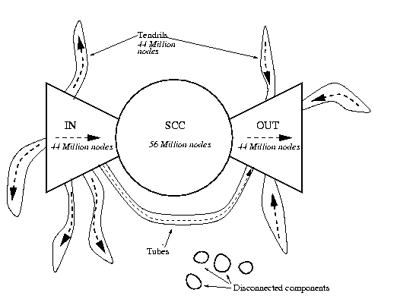
Exploratory Analysis: The Web
What is the structure and the properties of the web?

Slide 46
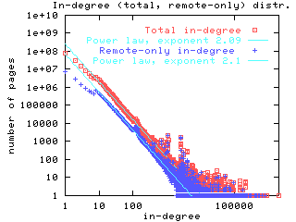
Exploratory Analysis: The Web
What is the distribution of the incoming links?

Slide 47
Connections of Data Mining with other areas
Draws ideas from machine learning/AI, pattern recognition, statistics, and database systems
Traditional Techniques may be unsuitable due to
Enormity of data
High dimensionality of data
Heterogeneous, distributed nature of data
Emphasis on the use of data
Statistics/ AI
Machine Learning/
Pattern Recognition
Data Mining
Database systems
Tan, M. Steinbach and V. Kumar, Introduction to Data Mining

Slide 48
Cultures
Databases: concentrate on large-scale (non-main-memory) data.
AI (machine-learning): concentrate on complex methods, small data.
In today’s world data is more important than algorithms
Statistics: concentrate on models.
CS345A Data Mining on the Web: Anand Rajaraman, Jeff Ullman

Slide 49
Models vs. Analytic Processing
To a database person, data-mining is an extreme form of analytic processing – queries that examine large amounts of data.
Result is the query answer.
To a statistician, data-mining is the inference of models.
Result is the parameters of the model.
CS345A Data Mining on the Web: Anand Rajaraman, Jeff Ullman

Slide 50
(Way too Simple) Example
Given a billion numbers, a DB person would compute their average and standard deviation.
A statistician might fit the billion points to the best Gaussian distribution and report the mean and standard deviation of that distribution.
CS345A Data Mining on the Web: Anand Rajaraman, Jeff Ullman

Slide 51
Data Mining: Confluence of Multiple Disciplines
Database
Technology
Statistics
Machine
Learning
Data Mining
Visualization
Pattern
Recognition
Other
Disciplines
Algorithm

Slide 52
Data Mining: Confluence of Multiple Disciplines
Database
Technology
Statistics
Machine
Learning
Data Mining
Visualization
Pattern
Recognition
Other
Disciplines
Algorithm

Slide 53
Data Mining: Confluence of Multiple Disciplines
Database
Technology
Statistics
Machine
Learning
Data Mining
Visualization
Pattern
Recognition
Distributed
Computing
Algorithm

Slide 54
Single-node architecture
CPU
Machine Learning, Statistics
Memory
“Classical” Data Mining
Disk

Slide 55
Commodity Clusters
Web data sets can be very large
Tens to hundreds of terabytes
Cannot mine on a single server
Standard architecture emerging:
Cluster of commodity Linux nodes, Gigabit ethernet interconnect
Google GFS; Hadoop HDFS; Kosmix KFS
Typical usage pattern
Huge files (100s of GB to TB)
Data is rarely updated in place
Reads and appends are common
How to organize computations on this architecture?
Map-Reduce paradigm

Slide 56
Cluster Architecture
2-10 Gbps backbone between racks
1 Gbps between
any pair of nodes
in a rack
Switch
Switch
Switch
CPU
CPU
CPU
CPU
Mem
…
Mem
Mem
…
Mem
Disk
Disk
Disk
Disk
Each rack contains 16-64 nodes

Slide 57
Map-Reduce paradigm
Map the data into key-value pairs
E.g., map a document to word-count pairs
Group by key
Group all pairs of the same word, with lists of counts
Reduce by aggregating
E.g. sum all the counts to produce the total count.

Slide 58
The data analysis pipeline
Mining is not the only step in the analysis process
Preprocessing: real data is noisy, incomplete and inconsistent. Data cleaning is required to make sense of the data
Techniques: Sampling, Dimensionality Reduction, Feature selection.
A dirty work, but it is often the most important step for the analysis.
Post-Processing: Make the data actionable and useful to the user
Statistical analysis of importance
Visualization.
Pre- and Post-processing are often data mining tasks as well
Data Preprocessing
Data Mining
Result
Post-processing

Slide 59
Data Quality
Examples of data quality problems:
Noise and outliers
missing values
duplicate data

Slide 60
Sampling
Sampling is the main technique employed for data selection.
It is often used for both the preliminary investigation of the data and the final data analysis.
Statisticians sample because obtaining the entire set of data of interest is too expensive or time consuming.
Sampling is used in data mining because processing the entire set of data of interest is too expensive or time consuming.

Slide 61
Sampling …
The key principle for effective sampling is the following:
using a sample will work almost as well as using the entire data sets, if the sample is representative
A sample is representative if it has approximately the same property (of interest) as the original set of data

Slide 62
Types of Sampling
Simple Random Sampling
There is an equal probability of selecting any particular item
Sampling without replacement
As each item is selected, it is removed from the population
Sampling with replacement
Objects are not removed from the population as they are selected for the sample.
In sampling with replacement, the same object can be picked up more than once
Stratified sampling
Split the data into several partitions; then draw random samples from each partition

Slide 63

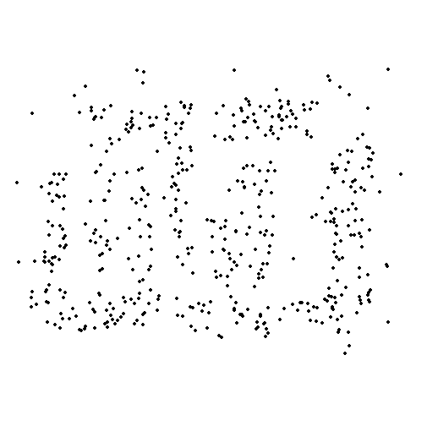
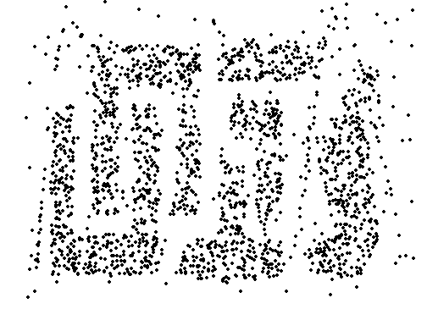
Sample Size
8000 points 2000 Points 500 Points

Slide 64

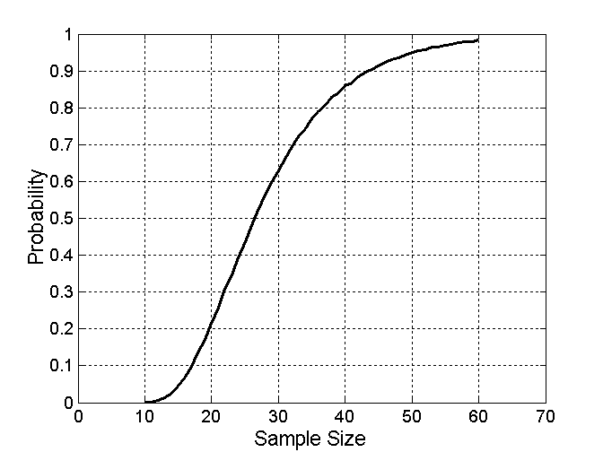
Sample Size
What sample size is necessary to get at least one object from each of 10 groups.

Slide 65
A data mining challenge
You are reading a stream of integers, and you want to sample one integer uniformly at random but you do not know the size (N) of the stream in advance. You can only keep a constant amount of integers in memory
How do you sample?
Hint: the last integer in the stream should have probability 1/N to be selected.
Reservoir Sampling:
Standard interview question

Slide 66
Meaningfulness of Answers
A big data-mining risk is that you will “discover” patterns that are meaningless.
Statisticians call it Bonferroni’s principle: (roughly) if you look in more places for interesting patterns than your amount of data will support, you are bound to find crap.
The Rhine Paradox: a great example of how not to conduct scientific research.
CS345A Data Mining on the Web: Anand Rajaraman, Jeff Ullman

Slide 67
Rhine Paradox – (1)
Joseph Rhine was a parapsychologist in the 1950’s who hypothesized that some people had Extra-Sensory Perception.
He devised (something like) an experiment where subjects were asked to guess 10 hidden cards – red or blue.
He discovered that almost 1 in 1000 had ESP – they were able to get all 10 right!
CS345A Data Mining on the Web: Anand Rajaraman, Jeff Ullman

Slide 68
Rhine Paradox – (2)
He told these people they had ESP and called them in for another test of the same type.
Alas, he discovered that almost all of them had lost their ESP.
What did he conclude?
Answer on next slide.
CS345A Data Mining on the Web: Anand Rajaraman, Jeff Ullman

Slide 69
Rhine Paradox – (3)
He concluded that you shouldn’t tell people they have ESP; it causes them to lose it.
CS345A Data Mining on the Web: Anand Rajaraman, Jeff Ullman

